Slide 1

Agentic AI for Disaster Management System
School of Computer Science Engineering and Information Systems
Winter Semester 2025-2026
Presented by Sakthipoorani D - 21MIS0333
under the guidance of Dr. Brindha K

Slide 2
Abstract: Revolutionizing Disaster Response
Rapid urbanization and climate change have heightened the vulnerability of urban regions to natural and human-induced disasters. Current disaster response systems often suffer from delayed response times, inefficient coordination, and suboptimal resource utilization due to their reactive, centralized, and human-dependent nature.
1
2
SOLUTION
KEY TECHNOLOGIES
AGENT-RESCUE Framework
Integrated AI Agents
This project proposes an Agentic AI-based framework for Disaster Response and Urban Emergency Management.
Utilizes Machine Learning for prediction, NLP and Computer Vision for assessment, and Reinforcement Learning for resource optimization.

Slide 3


Introduction: The Need for Intelligent Disaster Management
Disaster response and urban emergency management are critical for safeguarding lives, infrastructure, and economic stability. Urban disasters demand rapid, coordinated responses from multiple agencies, yet existing systems are often hampered by manual coordination and static decision-making under pressure.
Manual Limitations
AI-Enhanced Capabilities
Proactive Approach
Current systems struggle with high-pressure, rapidly evolving situations.
Shifting from reactive to predictive and adaptive disaster management.
Agentic AI introduces autonomous agents for dynamic, adaptive responses.

Slide 4

Problem Statement: Challenges in Urban Disaster Management
Urban disaster management systems face significant challenges in terms of efficiency and effectiveness. Most systems are reactive, lacking real-time situational awareness and heavily relying on human operators for critical decision-making. This often leads to:
Information overload and delayed responses.
Poor coordination among emergency services.
Lack of learning mechanisms for continuous improvement.
Inefficient resource allocation.
Limited transparency in decision-making.
A clear need exists for an intelligent, autonomous, and explainable system.

Slide 5
Objectives: Building an Autonomous Response System
1
2
3
Develop a Multi-Agent AI Framework
Predict Disasters with Machine Learning
Assess Real-time Situations (NLP, CV)
Design autonomous AI agents with specific responsibilities.
Analyze historical and real-time data for early warnings.
Evaluate emergency messages and visual data for urgency.
4
5
6
Optimize Resource Allocation (RL)
Provide Real-time Communication
Incorporate Explainable AI
Ensure transparency and accountability in decisions.
Minimize response time and maximize efficiency.
Automated alerts and coordination for all stakeholders.
7
Enable Continuous Learning
Post-disaster analysis for system improvement.

Slide 6

Scope of the Project: AGENT-RESCUE's Capabilities
This project focuses on the design, development, and evaluation of an intelligent disaster response system tailored for urban emergency management. It handles various disaster types, providing real-time monitoring, intelligent decision-making, and coordinated response.
Full-Stack Architecture
Web dashboard for admins, interactive citizen interface.
Autonomous Operation
Agentic AI allows human-in-the-loop control for critical decisions.
Scalable & Extensible
Future integration with smart city IoT, drones, etc.

Slide 7

Proposed System: AGENT-RESCUE Workflow
AGENT-RESCUE is an autonomous Agentic AI system designed to support human decision-makers throughout the entire emergency response lifecycle, from detection to post-event learning.
Data Collection
Disaster Prediction
Situation Assessment
Resource Allocation
Communication & Learning
Data Collection
Disaster Prediction
Situation Assessment
Resource Allocation
Continuous monitoring from historical, real-time, and citizen sources.
ML models analyze data, generate risk scores, trigger alerts.
NLP & CV evaluate real-time conditions, assign severity.
RL optimizes deployment of emergency assets.
Communication & Learning
Disseminates alerts, provides assistance, and retrains models.

Slide 8
Literature Survey: Identified Strengths
A comprehensive review of existing literature reveals several strengths in AI applications for disaster management, which AGENT-RESCUE builds upon.
Effective AI for Prediction
Improved Multi-Agent Coordination
Real-Time Situational Awareness
Machine learning models significantly improve disaster prediction accuracy.
Decentralized systems enhance task parallelization and collaboration.
Social media, IoT, and computer vision provide immediate insights.
Reinforcement Learning Optimization
Growing Explainable AI Importance
Optimal resource allocation based on learned strategies.
Transparency and accountability in AI-driven public safety decisions.

Slide 9
Literature Survey: Addressing Key Limitations
Despite advancements, current systems face limitations that AGENT-RESCUE is designed to overcome, offering a more integrated and adaptive solution.
Limitations Identified
AGENT-RESCUE's Solutions
Lack of End-to-End Autonomy
Limited Learning and Adaptability
High Dependence on Human Operators
Poor Explainability in Decisions
Fragmented System Architectures
End-to-End Agentic AI Framework: Coordinated agents for full lifecycle.
Continuous Learning Mechanism: RL and feedback-based retraining.
Reduced Human Dependency: Autonomous tasks with human oversight.
Explainable AI Integration: Decision explanations and reasoning modules.
Unified and Scalable Architecture: Seamless data flow and coordination.

Slide 10
Methodology: Systematic Design & Development
The project adopts a systematic, modular, and iterative approach, divided into six phases, to create an intelligent and adaptable disaster response system.
Phase 1: Data Acquisition
Collecting diverse data from historical records, sensors, and citizens.
Phase 2: Data Preprocessing
Cleaning, normalizing, and engineering features for model readiness.
Phase 3: Disaster Prediction
ML models train to predict disaster likelihood and severity.
Phase 4: Situation Assessment
NLP and CV evaluate real-time emergency conditions.
Phase 5: Resource Allocation
Reinforcement learning optimizes resource deployment.
Phase 6: Communication & Feedback
Alerts, guidance, and continuous model retraining.

Slide 11




FUNCTIONAL REQUIREMENTS
Core Capabilities of AGENT-RESCUE
Disaster Data Collection & Management
Disaster Prediction Module
Citizen Assistance Module
Explainable AI & Decision Transparency
Collects and stores disaster-related data from various sources (historical data, weather APIs, emergency reports, sensor data) in both structured and unstructured formats.
Analyzes incoming data with machine learning models to predict disaster probability, type, and severity, generating risk scores and early warning alerts.
Offers a chatbot interface for citizens to receive emergency guidance, first-aid instructions, shelter locations, and safety measures.
Provides clear explanations for predictions and allocation decisions, ensuring transparency and accountability in critical situations.

Slide 12
FUNCTIONAL REQUIREMENTS
Advanced Functional Requirements
Situation Assessment
Resource Optimization
Processes real-time emergency messages via NLP and analyzes images with Computer Vision to gauge urgency and impact.
Intelligently allocates emergency resources (ambulances, fire trucks, hospitals) using reinforcement learning.
Real-Time Communication
Post-Disaster Learning
Delivers instant alerts and notifications to authorities, hospitals, NGOs, and citizens through dashboards and messaging.
Analyzes response outcomes and continuously retrains models to enhance future decision-making.

Slide 13
NON-FUNCTIONAL REQUIREMENTS
Ensuring System Quality and Robustness
Operational Excellence
Security and Maintainability
Scalability: Handles growing data volumes, users, and emergency events without performance degradation.
Reliability & Availability: Operates continuously with minimal downtime, especially during critical periods.
Performance: Processes data and generates decisions in near real-time for timely responses.
Security: Enforces authentication, authorization, and secure data storage to protect sensitive information.
Explainability & Trust: Ensures AI decisions are interpretable for users and authorities.
Fault Tolerance: Continues functioning even if one or more modules fail.
Maintainability: Modular design allows for easy updates, modifications, and extensions.

Slide 14
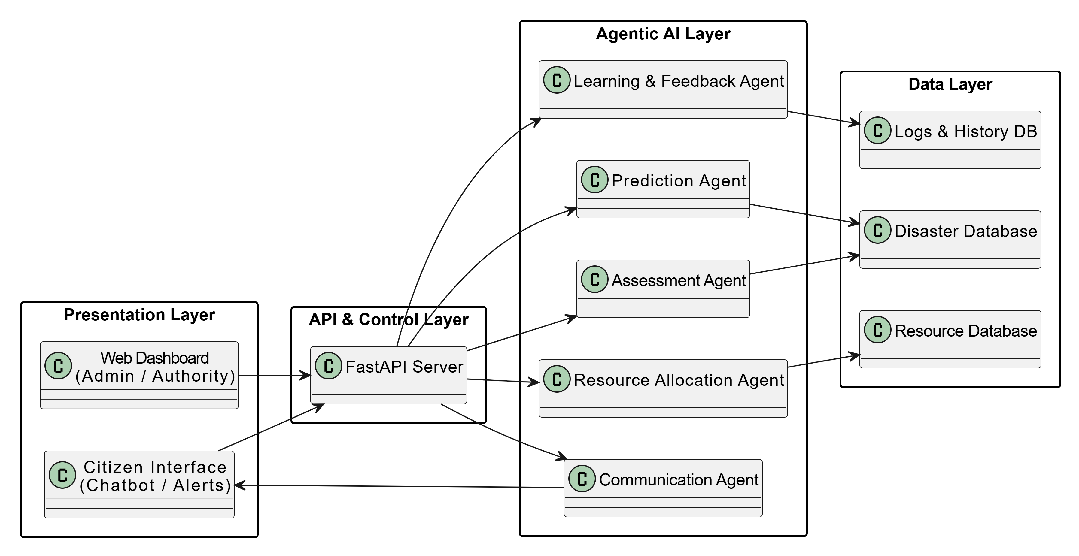
SYSTEM ARCHITECTURE
Layered and Modular Design
The AGENT-RESCUE system employs a layered and modular design to ensure scalability, maintainability, and real-time performance. This architecture is structured into four distinct layers, each with a defined role, communicating via well-established interfaces.

Slide 15
ARCHITECTURE BREAKDOWN
Components of the AGENT-RESCUE Architecture
Presentation Layer
API and Control Layer
Agentic AI Layer
Data Layer
Web-based dashboard for authorities and a chatbot for citizens, providing real-time data and safety guidance. Uses secure REST APIs and WebSockets for dynamic updates.
The core intelligence, comprising autonomous AI agents for prediction, assessment, resource allocation, communication, and continuous learning. Agents communicate asynchronously for efficient decision-making.
Manages data storage in relational (structured data) and NoSQL (unstructured data) databases. Utilizes caching mechanisms for rapid data access, ensuring persistence and consistency.
Central communication hub built with FastAPI, managing requests, data validation, authentication, and routing to AI agents. Orchestrates agent interactions based on system events.

Slide 16





AI AGENTS IN ACTION
Autonomous Intelligence for Emergency Response
Assessment Agent
Prediction Agent
Evaluates emergency severity using NLP and computer vision.
Analyzes data to estimate disaster risk.
Resource Agent
Optimizes deployment of emergency resources.
Learning & Feedback Agent
Communication Agent
Evaluates system performance and updates models.
Handles alert dissemination and coordination.
Each agent plays a crucial role, working collaboratively to enhance response effectiveness.

Slide 17
CONCLUSION
The Impact of AGENT-RESCUE
Enhanced Preparedness & Response
Future-Proofing Urban Resilience
Reduces response time significantly.
Improves coordination among emergency services.
Supports informed decision-making during critical situations.
Modular and scalable architecture for future smart city integrations.
Foundational for research and real-world deployment of autonomous AI.
Contributes practical solutions for urban emergency management.
AGENT-RESCUE is not just a system; it's a leap forward in ensuring the safety and resilience of our urban environments.

Slide 18
Thank you!

